Slide 1

Geo-Crawler
Prepared by
Deepak Punjabi (15IT60R17)
Under Guidance of
Professor Soumya K. Ghosh
Notes:
This is a note

Slide 2
Spatial data
is data containing Information about the locations and shapes of geographic features and the relationships between them, usually stored as coordinates and topology.
Source: http://support.esri.com/

Slide 3
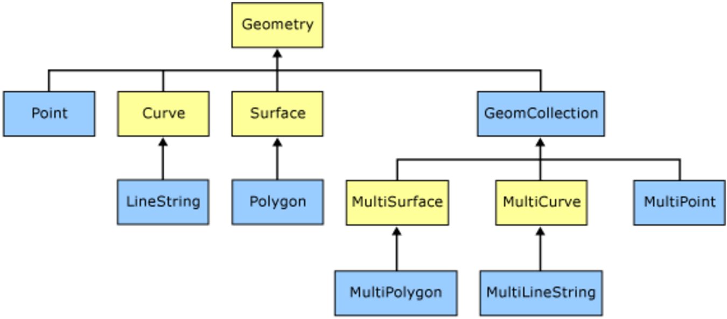
Spatial Object Types
Source: msdn.microsoft.com

Slide 4

OGC Web Services
WMS
Deliver map images
Metadata about available layers
GetCapabilities, GetMap, DescribeLayer
WFS
Direct access to features
GML/SOAP interface
Query/get feature
Add feature
Delete feature
Update feature
WCS
Multi-dimensional coverage of data
Provides sptio-temporal information
Provides rich semantics than WMS and WFS

Slide 5
3 terabytes
on daily basis
Source : [NASA:2007]

Slide 6
How to search spatial data ?
Catalog Approach
Registry not up to date
Incorrect classification of services
Not all service providers registers, all kind of services
Utilize popular search engines
Google, Yahoo, Bing etc.
Uses page rank, instead of quality of service (QoS)

Slide 7
What is a Crawler ?
“ A program that systematically browses the
World Wide Web
in order to create an index of data. ”
E.g. bingbot, polybot, googlebot
Challenges
Scale of the web
Refresh rate
heterogeneity
Types of Crawler
Universal crawler
Focused crawler
Topical crawler

Slide 8
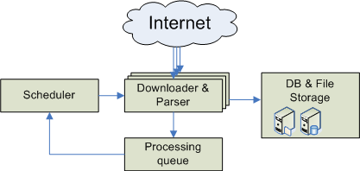
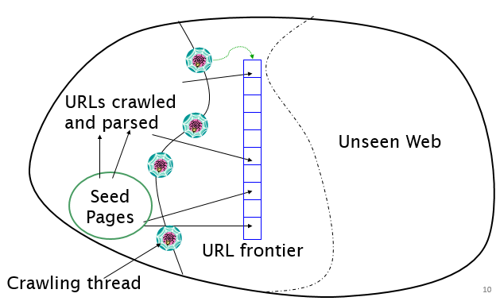
How it works ?
Here you have a list of items
And some text
But re
Source: nazou.fiit.stuba.sk/home/?page=webcrawler

Slide 9

Spatial Web Crawler: Objectives
Building a spatial web crawler using WFS based on OGC standard.
Building a domain ontology with spatial feature type.
Semantic matching using ontology and indexing of geo-servers with offered feature type reference.
Performing experiment with test seed URLs and analysing the performance of the crawler in terms of accurate semantic annotations.

Slide 10

Crawler Architecture
Analysis &
Indexing module
Extract features
Perform a semantic match
Compare extracted features with ontology
Add geo-server to repository
Extraction module
Read URL from URLQue
Extract hyperlinks
Remove duplicates
Push to URLQueue
WFS module
Generate GetCapabilities request by appending to URL
Check whether server is a WFS server via XML response

Slide 11
Ontology
Seed URLs
Extraction Module
Get FeatureTypeList
Remove duplicate URL
Initialize
Enqueue
List of features
URLQueue
Parse FeatureTypeList
Check <Name>, <Title>, <Keyword>
Perform semantic match
Extract
Hyperlinks
Extract URLs
Parse
Source page
Filter
Stage
Parser
Yes
For all feature
Feature
definition
Found in ontology
Match found?
Remove checked
DescribeFeatureType
WMS
Resolver
WFS Module
Add to persistence
storage
Geo
Server?
Analysis & Indexing Module
Repository
GetCapabilities()
Crawler Architecture

Slide 12
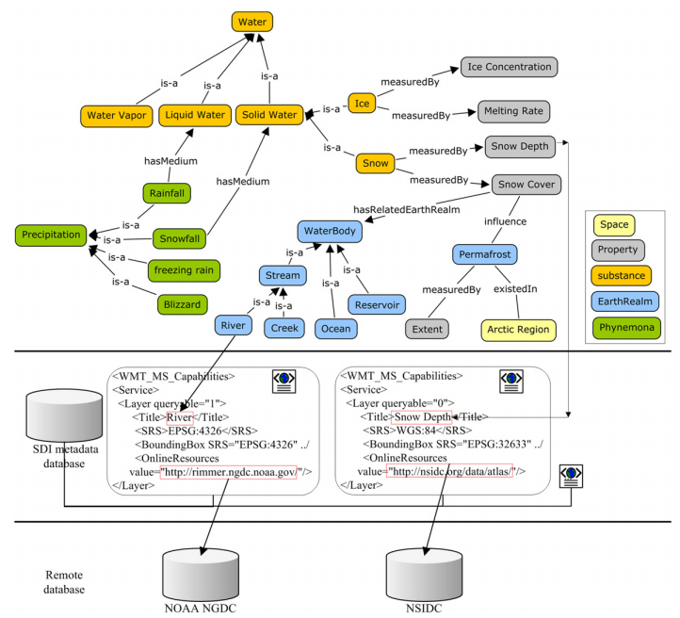
Example
Query
source: Li, W., et al. Computers & Geosciences,2011.

Slide 13

Advantages of Spatial web crawler
Allows searching of pages that are currently not searchable from the general search engines
Provides a more up-to-date search
Provides improved accuracy and extra features not possible with general search engines

Slide 14


Performance Evaluation
Here
text
Re
Final score is calculated by taking average over all feature types.

Slide 15
Future work & Extensions
Priority based crawling
Parallelization
Cloud based crawler implementation
Spatial search engine & ranking

Slide 16
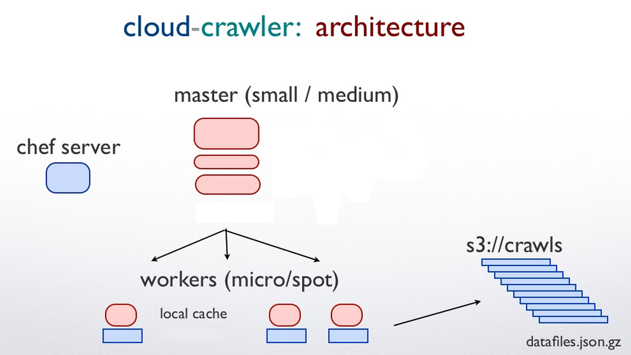
source: charlesmartin14.wordpress.com/2013/04/22/cloud-crawler-an-open-source-ruby-dsl-for-crawling-the-web/

Slide 17
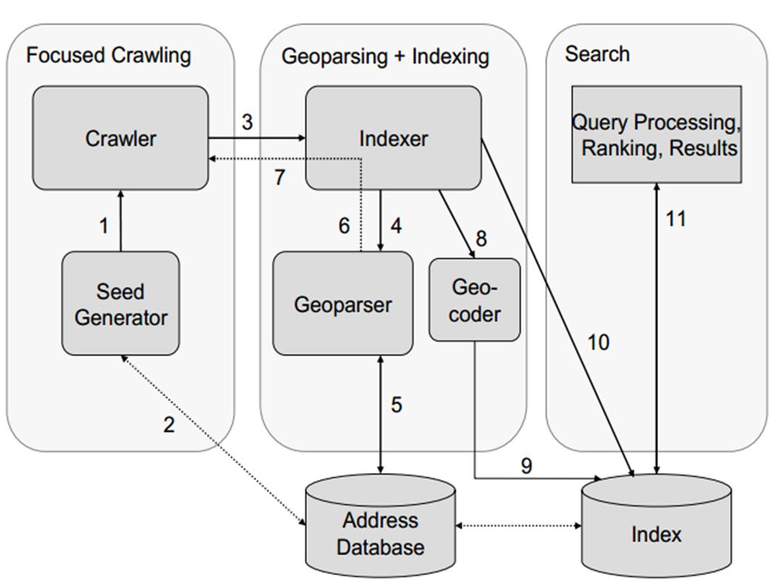
Architecture of a spatial search engine [Source: Ahlers et al. Springer London, 2009.]

Slide 18

References
Patil, Sonal, Shrutilipi Bhattacharjee, and Soumya K. Ghosh. "A spatial web crawler for discovering geo-servers and semantic referencing with spatial features." Distributed Computing and Internet Technology. Springer International Publishing, 2014. 68-78.
Li, Wenwen, Chaowei Yang, and Chongjun Yang. "An active crawler for discovering geospatial web services and their distribution pattern–a case study of OGC web map service." International Journal of Geographical Information Science 24.8 (2010): 1127-1147.
Jiang, Jun, Chong-jun Yang, and Ying-chao Ren. "A spatial information crawler for opengis wfs." Sixth International Conference on Advanced Optical Materials and Devices. International Society for Optics and Photonics, 2008.
Marc Najork. “Web crawler architecture.” Microsoft Research.
Ahlers, Dirk, and Susanne Boll. "Location-based Web search." The Geospatial Web. Springer London, 2009. 55-66.
Li, W., et al. "Semantic-based web service discovery and chaining for building an Arctic spatial data infrastructure." Computers & Geosciences 37.11 (2011): 1752-1762.

Slide 19
Thanks!
Any questions ?

